Slide 1











Sportify
Ali Ammar
Mojtaba Kodsi

Slide 2












Agenda
Introduction
Technologies
Similar applications
Demo
UML Diagrams
Conclusion

Slide 3


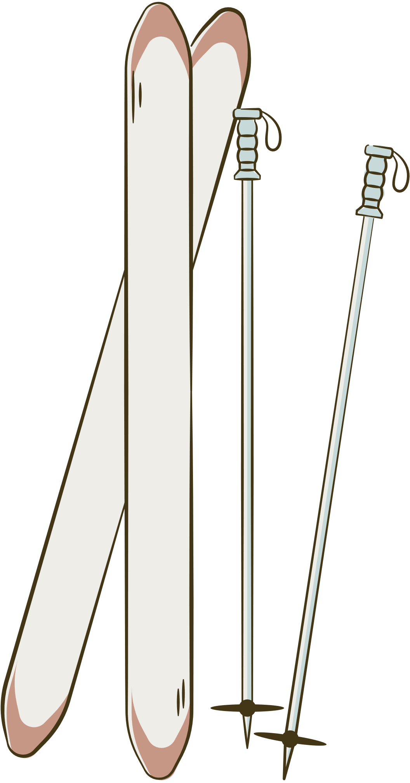


Introduction
Overview
Problem Statement
Proposed Solution

Slide 4



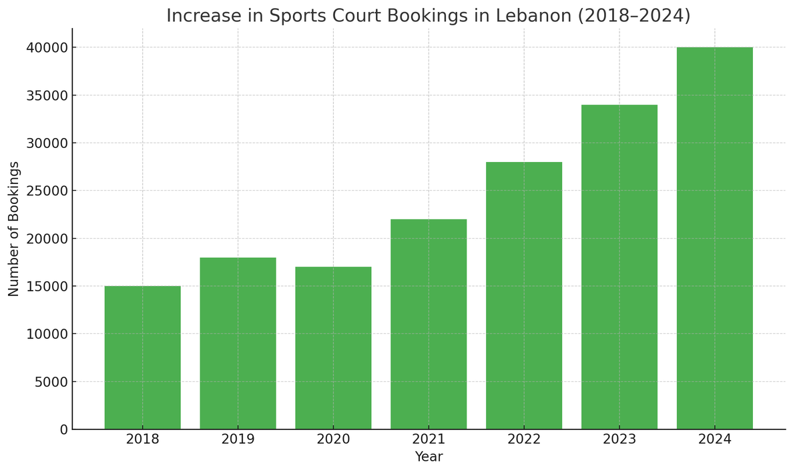


Overview
2024 industry report by 6Wresearch

Slide 5


Problem Statement
Poor communication between owners and players
Inefficient tracking of finances for owners
Scheduling conflicts and double bookings
Players not owning suitable equipment

Slide 6
Proposed Solution
Sportify
is a platform that:
Eases the communication between owners and players.
Manages bookings and prevents confusion.
Creates a clear financial dashboard for owners.
Grants various options for players to book suitable stadiums and equipment.

Slide 7
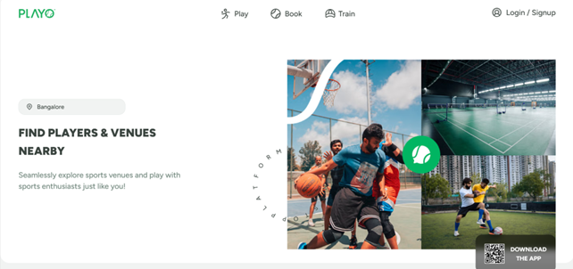
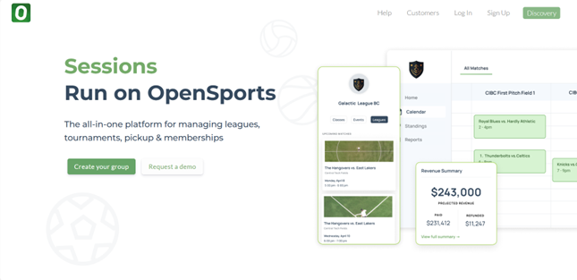
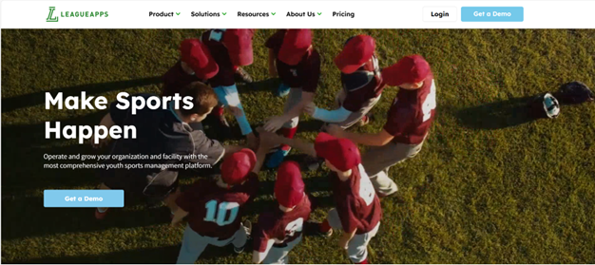
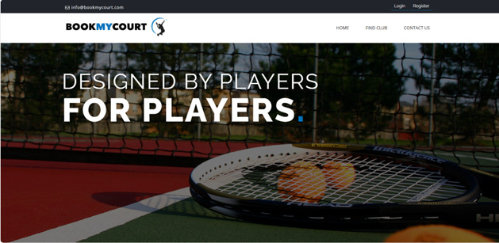
Similar Applications
Playo
Open Sports
LeagueApps
BookMyCourt

Slide 8

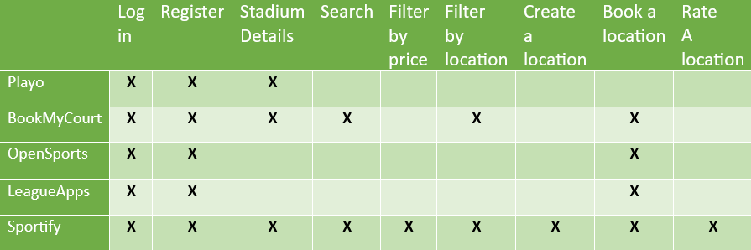

Slide 9
UML Diagrams
Use Case Diagram
Relational Schema

Slide 10
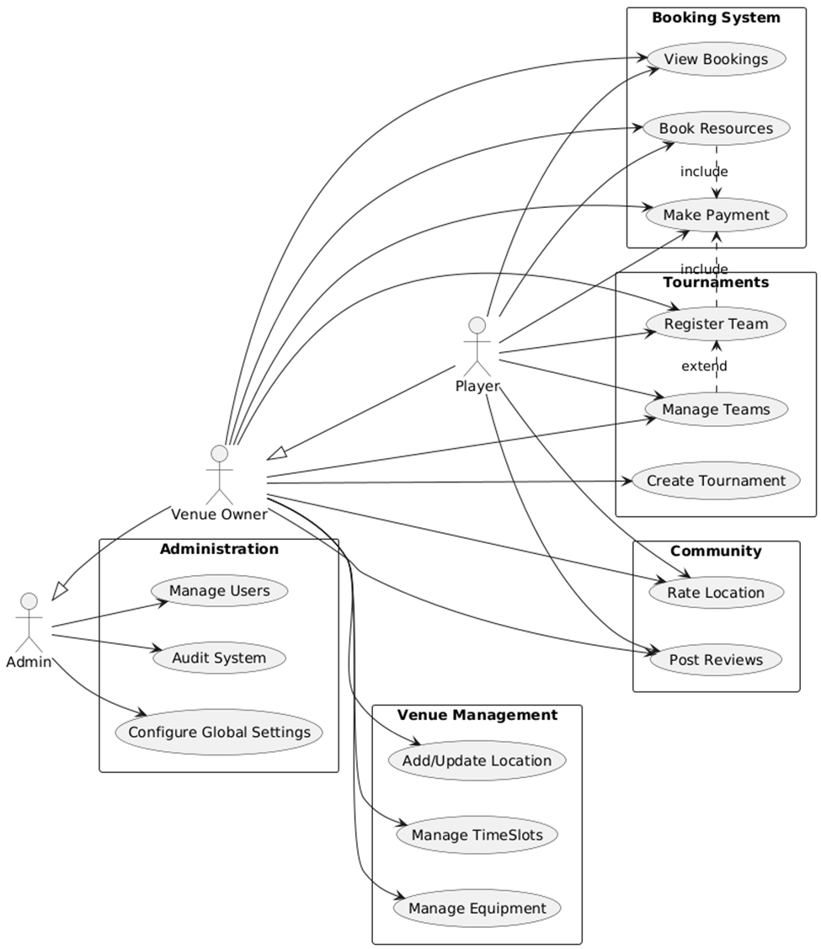
Use Case
Diagram

Slide 11
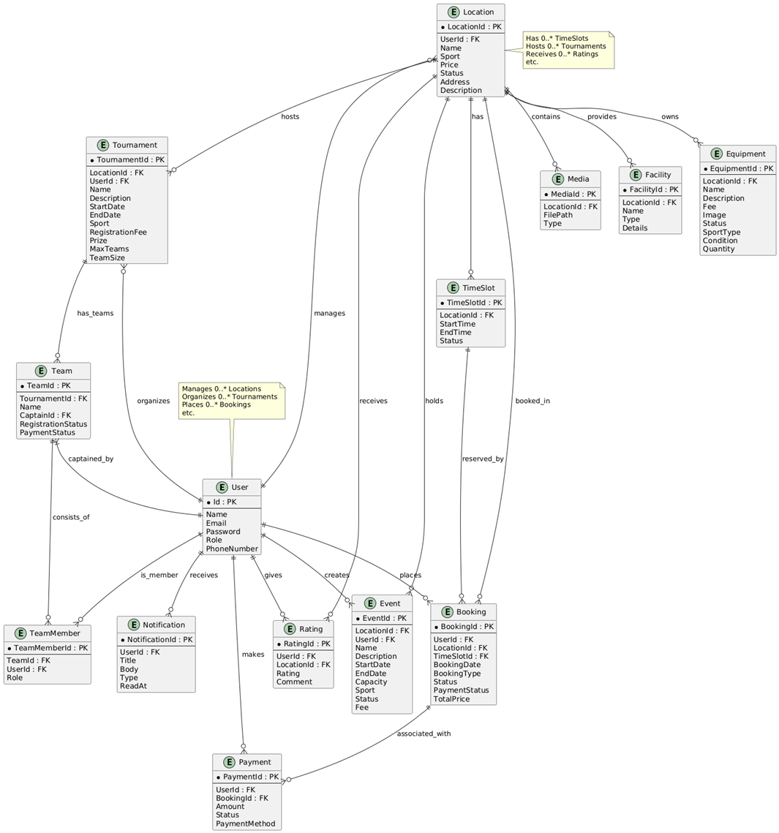
Relational
Schema

Slide 12

Technologies
Back-end technologies.
Front-end technologies.
Features.

Slide 13




Front-end Technologies
HTML
Tailwind
React
Flutter

Slide 14



Back-end Technologies
Laravel
PHP
MySQL

Slide 15
Features
Booking
Analytics
AI chatbot
Events

Slide 16
Conclusion
Future Plans
Reflections
Importance of organized teamwork
Deployment
More AI features including weather forecast
Greatly improved skills in developing
Working on a Real-World application
Entering the market

Slide 17



Demo

Slide 18
Thank
You

